Slide 1
Linear Regression
CSE 404 - Artificial Intelligence Lab

Slide 2
Simple Linear Regression

Slide 3
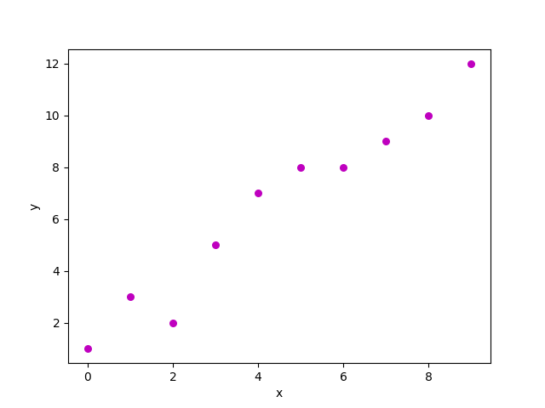
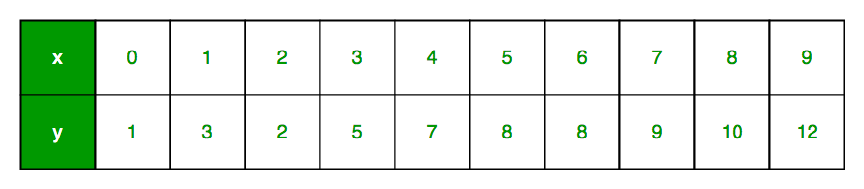
Single Independent Variable

Slide 4
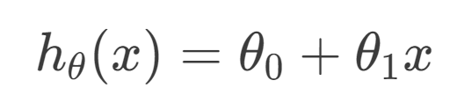
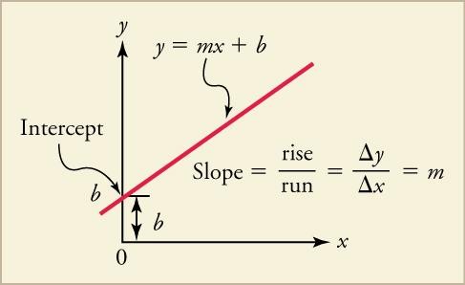
Hypothesis Function
Linear
y = mx + b

Slide 5
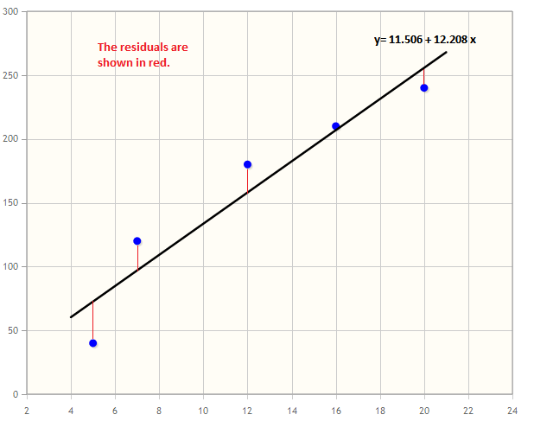
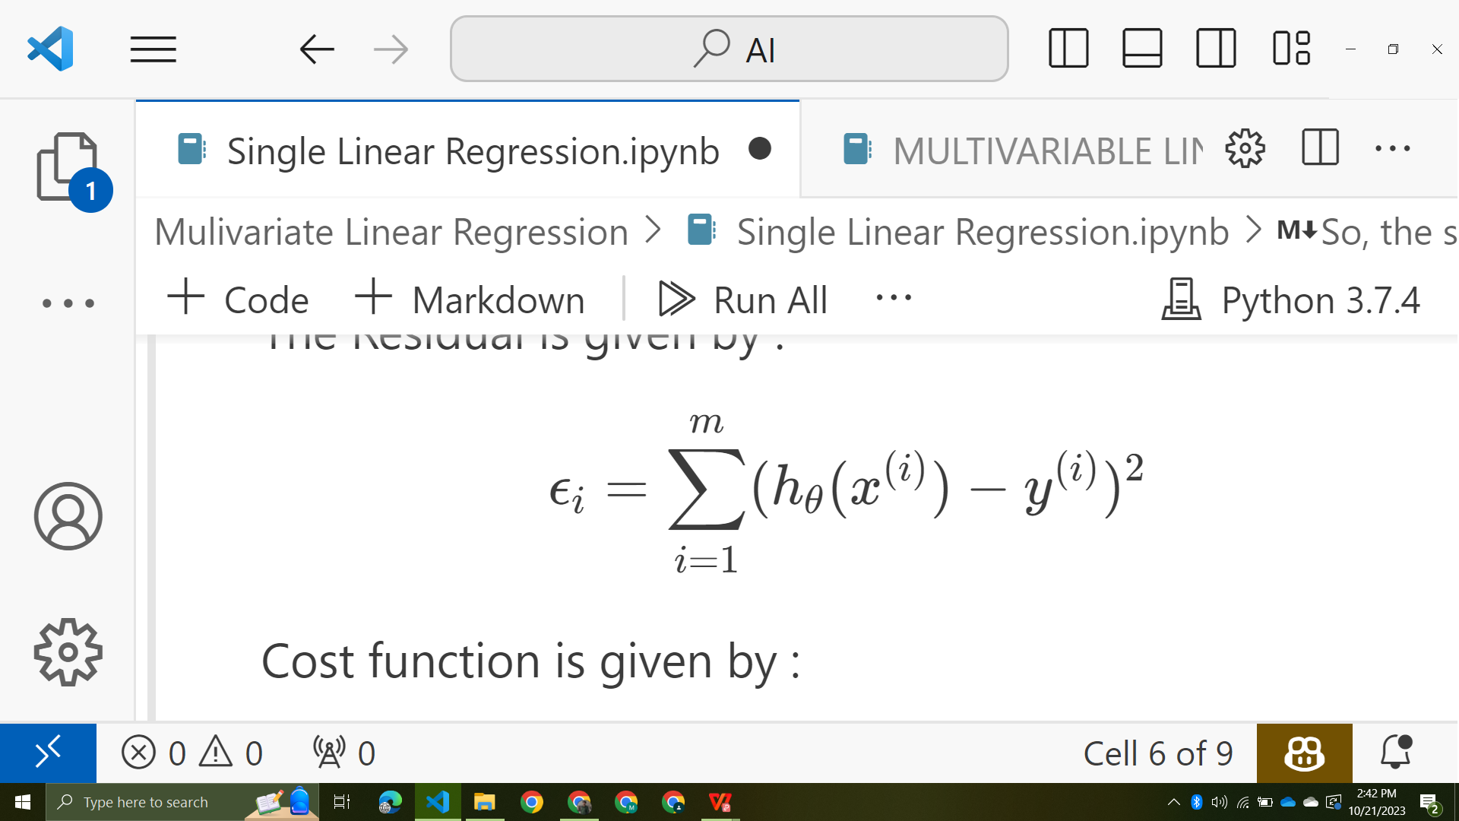
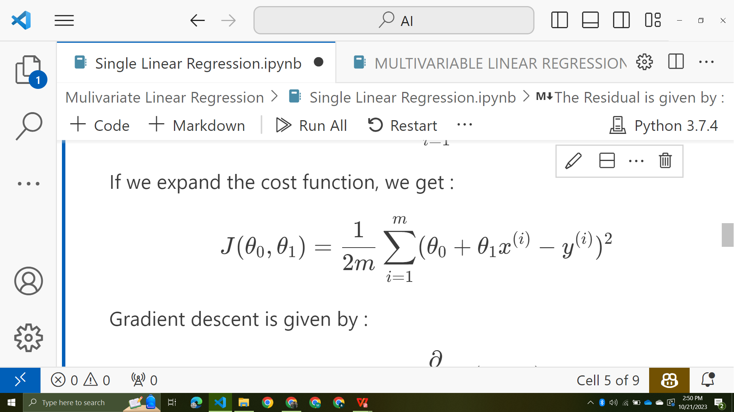
Residual

Slide 6
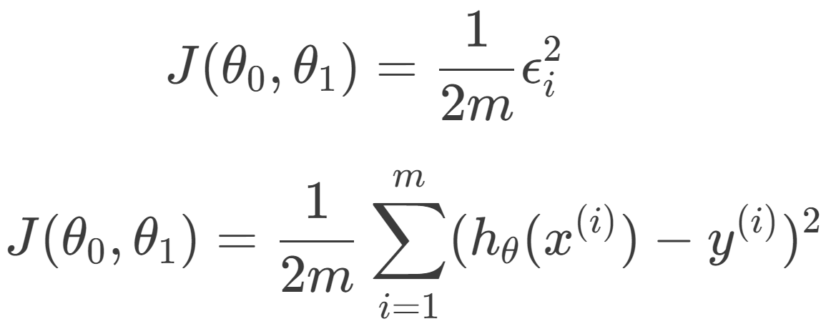
Cost Function

Slide 7
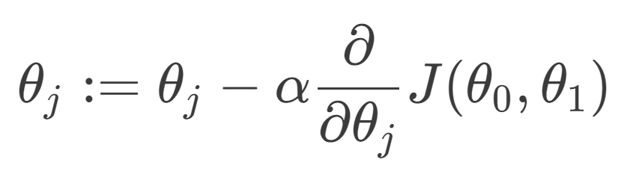
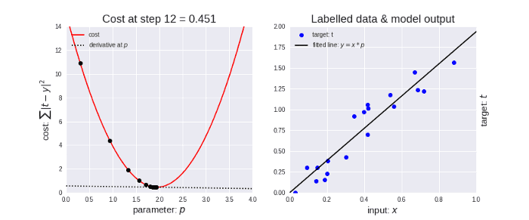
Gradient Descent

Slide 8
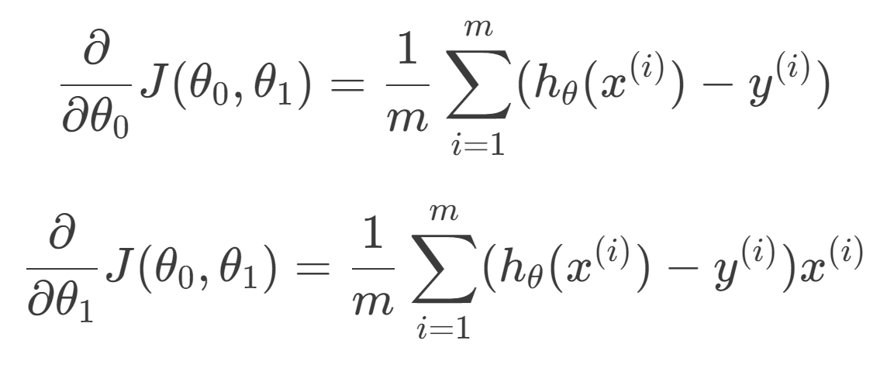
The Gradients
Differentiating, we get
The Cost Function

Slide 9
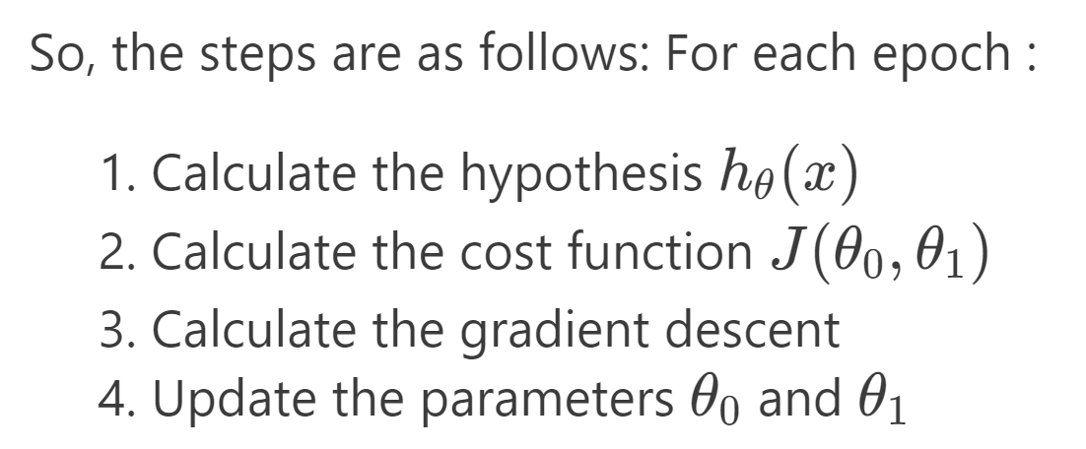
Summary

Slide 10
Multivariate Linear Regression

Slide 11
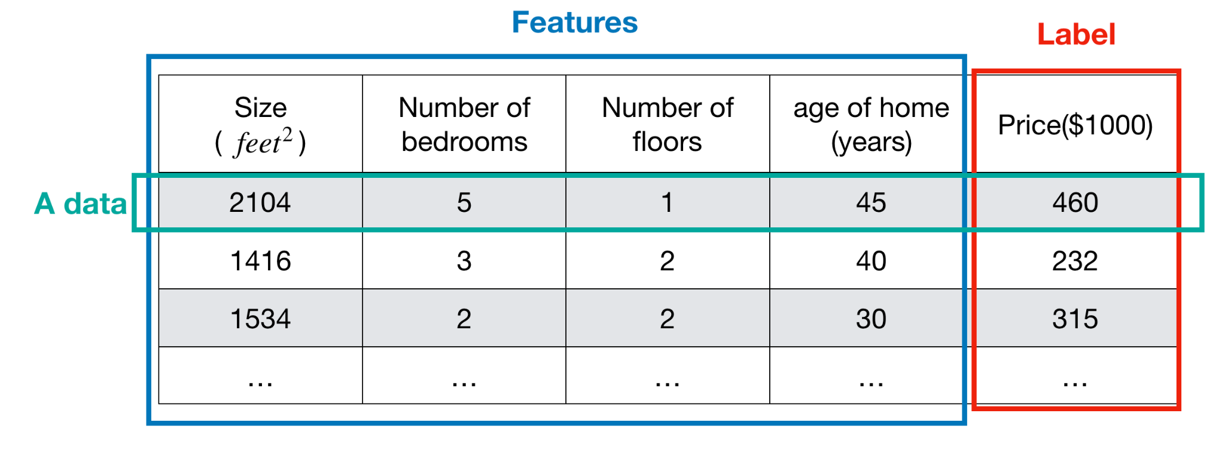
Multiple Independent Variable

Slide 12
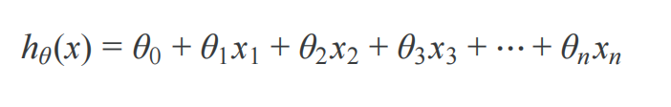
Hypothesis Function

Slide 13
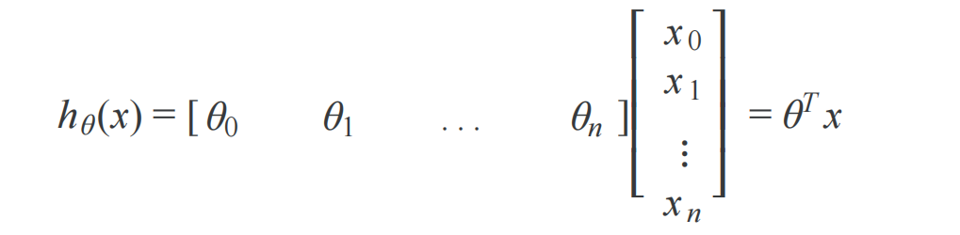
Hypothesis Function
Matrix Multiplication Form

Slide 14
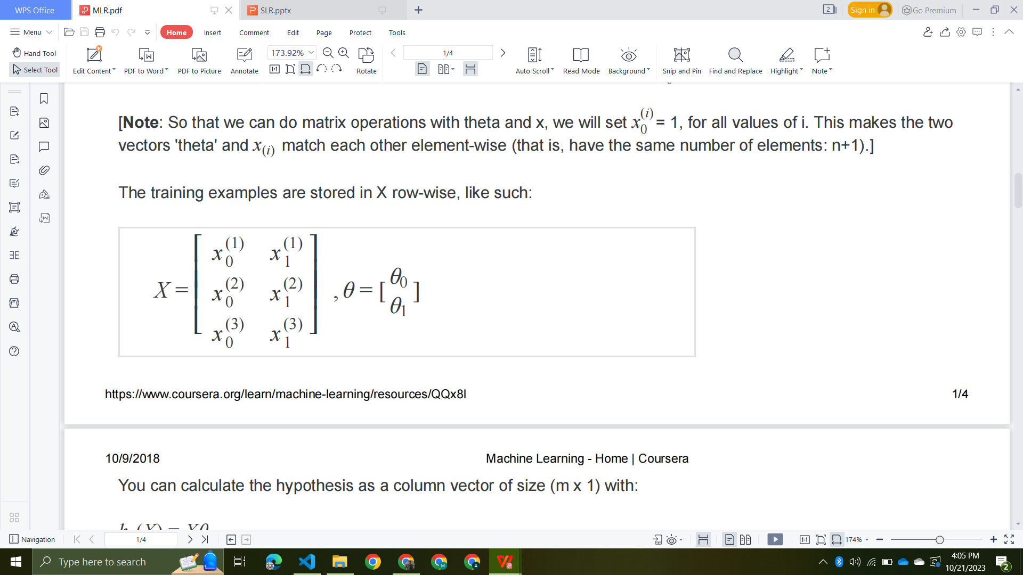
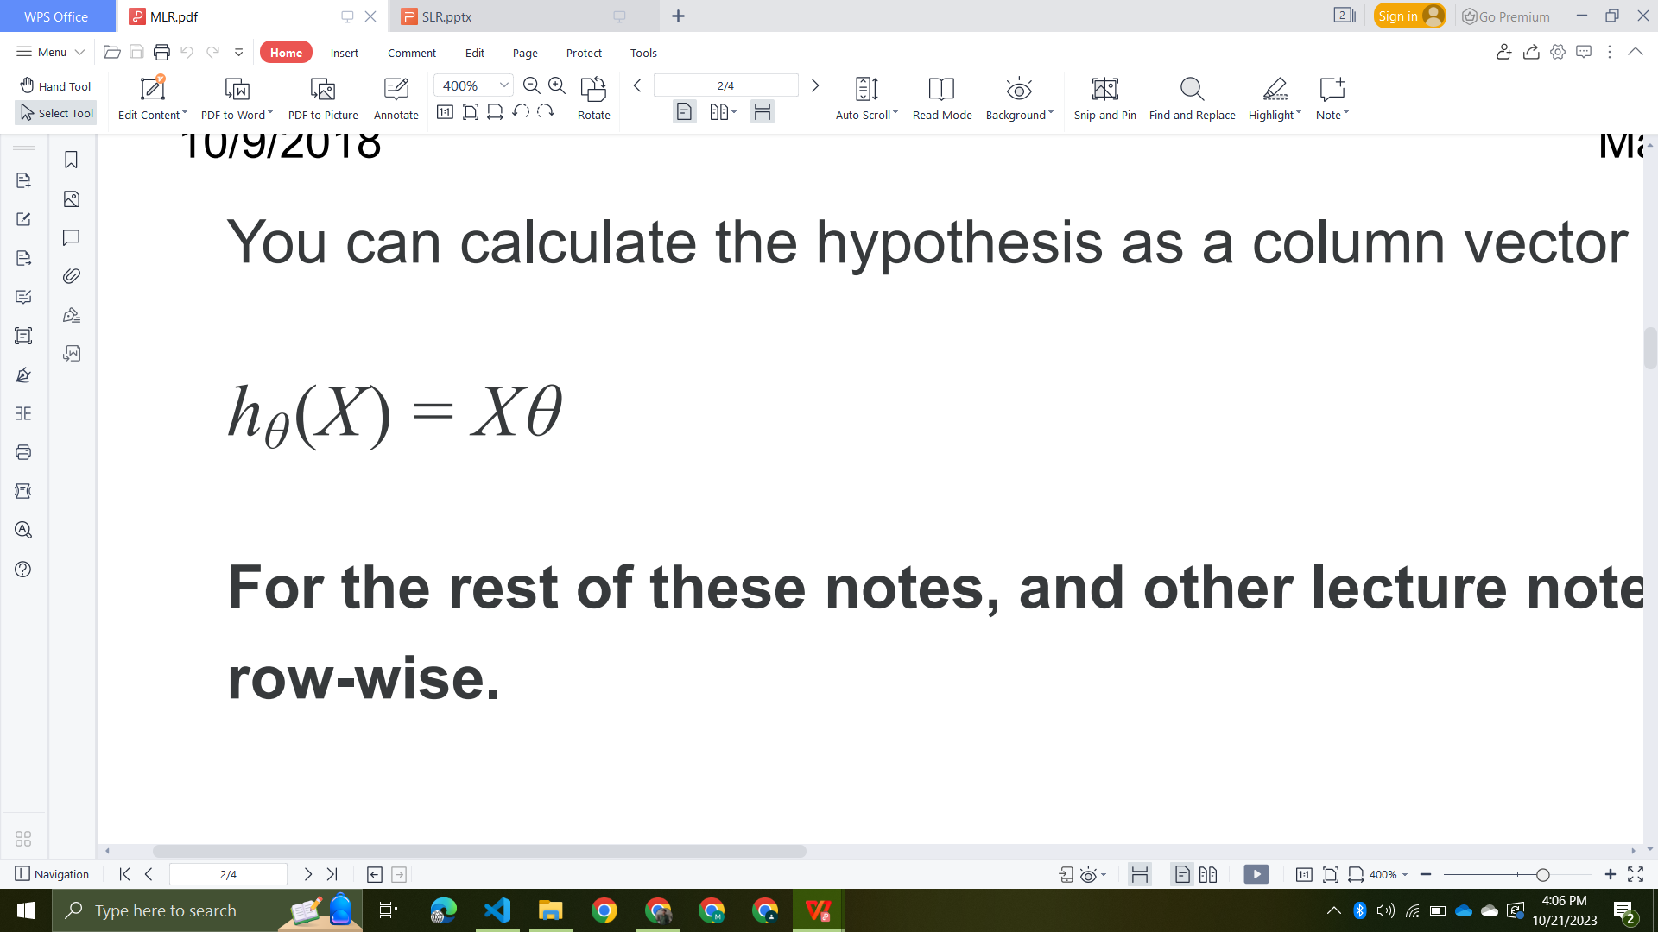
Hypothesis Function
Feature vector (2 records and 3 features) :
So the hypothesis function is :

Slide 15
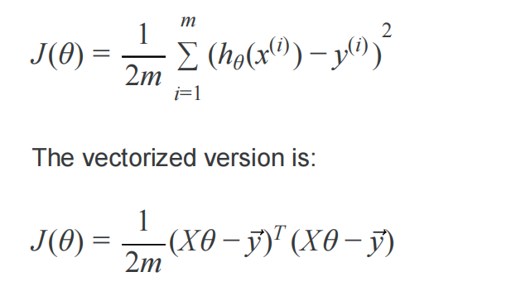
Cost Function

Slide 16
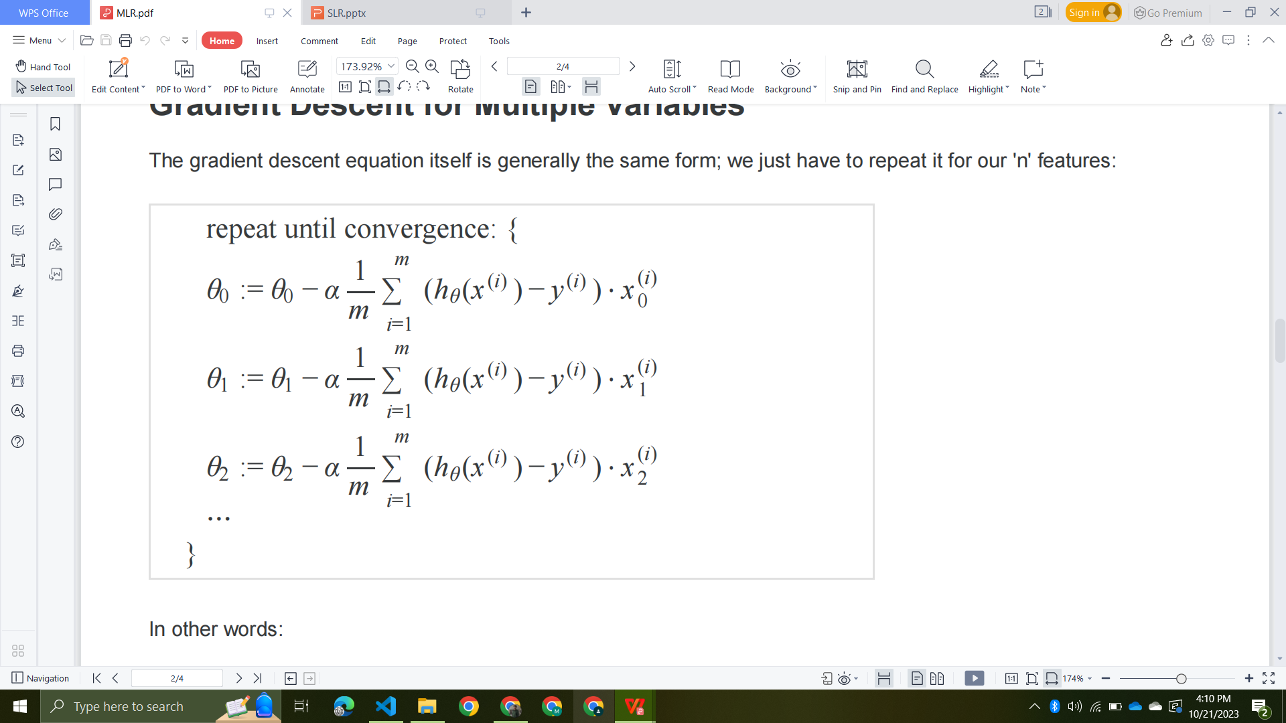
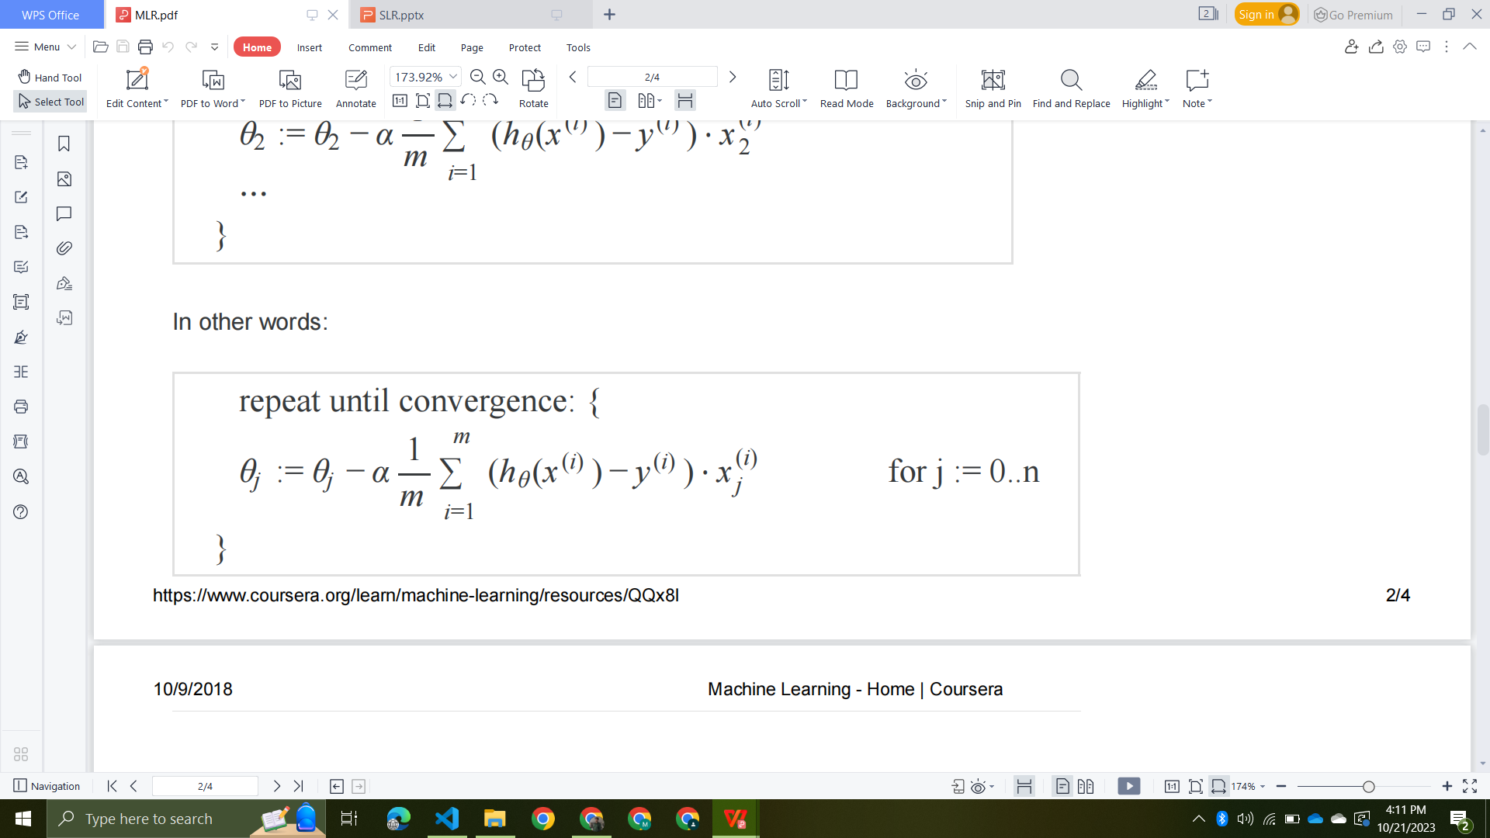
Gradient Descent

Slide 17
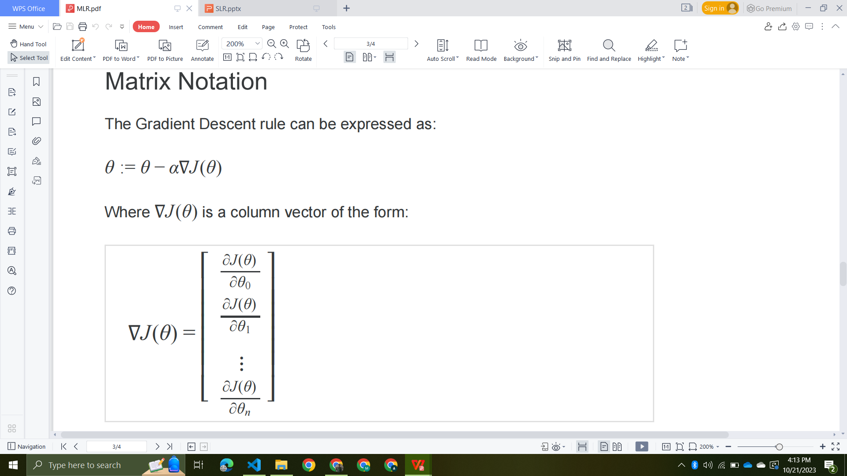
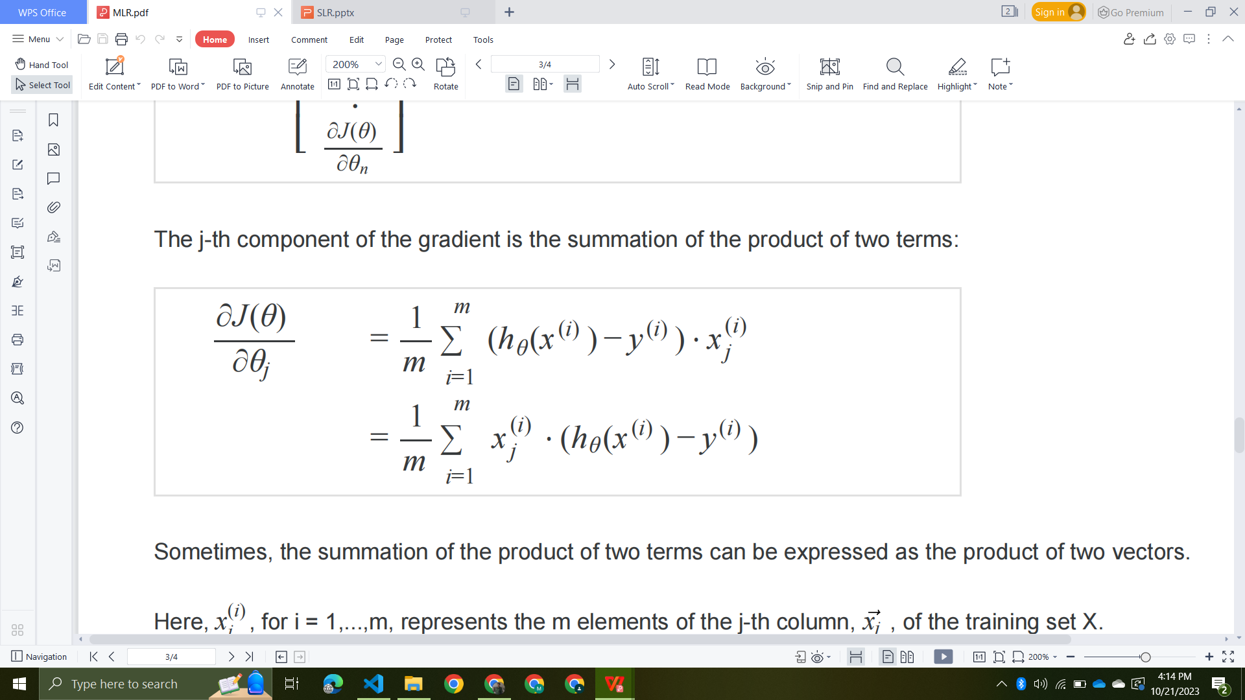
Gradient Descent (Matrix Notation)

Slide 18
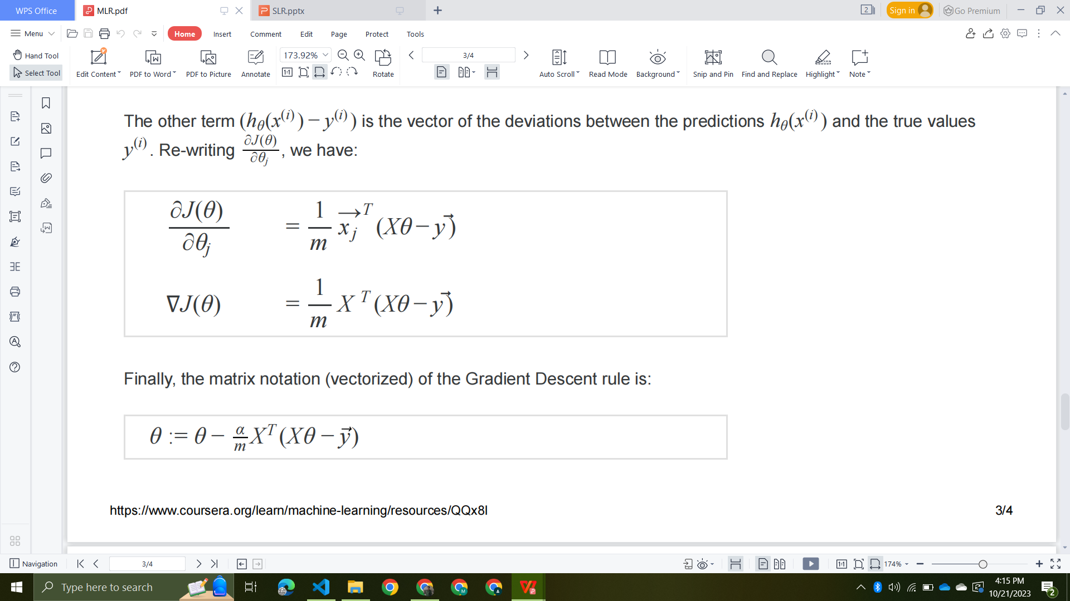
Gradient Descent (Matrix Notation)

Slide 19
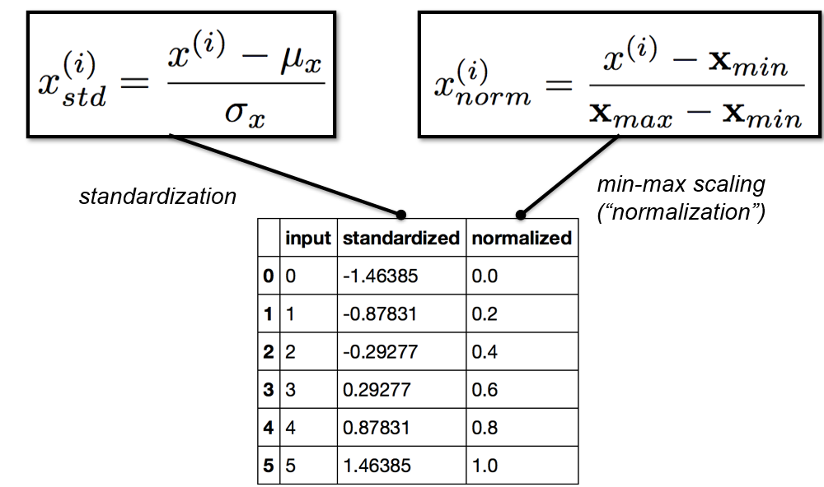
Feature Standardization/Normalization

Slide 20
Summary
Step 1 : Select the features
Step 2 : Normalize the feature
Step 3 : Select loss function and formulate a hypothesis
Step 4 : Minimize the cost and loss function
Step 5 : Test the hypothesis

Slide 21
Model Evaluation

Slide 22
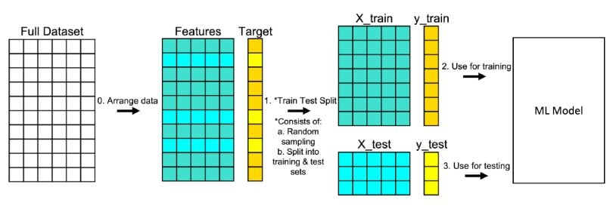
Train Test Split

Slide 23
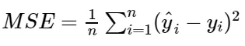
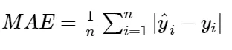
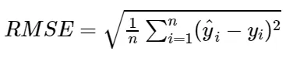
Metrics

Slide 24
Linear Regression
with SK-Learn

Slide 25
Scikit Learn
https://realpython.com/linear-regression-in-python/#multiple-linear-regression-with-scikit-learn

